Slide 1
The Fama-French Five Factor Model: Overkill?
By: Harrison Li, Cecilia Zhou, Lawrence Kim, Stefan Spataru, Ricky Li

Slide 2
Review: Fama-French three factor asset pricing model
Developed by UChicago Nobel-prize winning economists Eugene Fama and Kenneth French
Noticed small stocks (low market cap) and value stocks (low P/B ratio) tend to generate systematically higher returns
Model “regresses out” these factors
Alpha: “risk-adjusted” return of the asset

Slide 3
The Five Factor Model
In 2014, Fama and French published a paper recommending the addition of two additional factors
Conservative Minus Aggressive (CMA)
Robust Minus Weak (RMW)
Overfitting concerns
For HFAC’s portfolio, do the two additional factors tell us any new information?

Slide 4
Conservative Minus Aggressive (CMA) factor
Returns of low investment (conservative) firms minus returns of high investment firms (aggressive) (as measured by investment in book equity)
Fama and French’s claim: this factor captures a specific risk of a company that is not captured in Beta, SMB, HML, RMW.
The CMA factor (like the other betas) tends to be positive

Slide 5
Why is CMA positive?
“Aggressive” companies tend to perform worse
Investing in book value suggest inability to generate profit from operations and that the company wants to secure its cash
“Conservative” companies (which do not invest as much in their book value, instead investing in their operations) tend to be more risky- again since aggressive companies secure their cash by investing in book value. Higher average returns are needed to compensate.
More cynical view: management is generally bad at investing in assets

Slide 6
Robust Minus Weak (RMW) factor
The difference between the returns on diversified portfolios of stocks with “robust” and “weak” operating profitability (OP).
OP = Revenues - COGS - SG&A - Interest expense (divided by book equity)
With RMW, Fama & French HML is unnecessary: value stocks behave like stocks with high OP
High OP correlates with high P/B
Some believe RMW is not grounded in economic theory

Slide 7
The intuition behind RMW
Robust (more profitable) firms generate significantly higher average future return since they tend to generate more robust cash flows and are less prone to distress.
Weak (less profitable) firms are more likely to run out of cash and thus generate lower average future return.
The research of Novy-Marx (2013) highlights the importance of the “profitability factor”

Slide 8
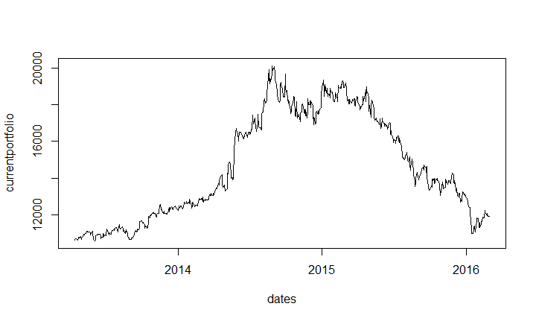
Historical prices of HFAC’s current* portfolio
*As of 4/1/16

Slide 9
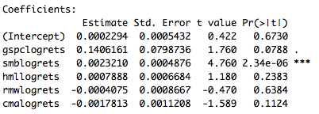
Results

Slide 10
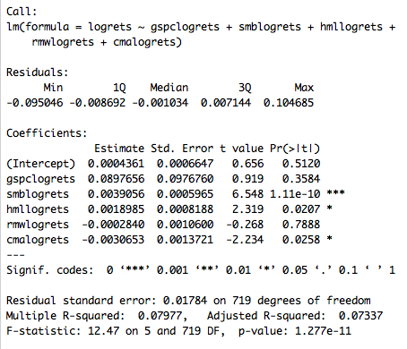
CTO

Slide 11
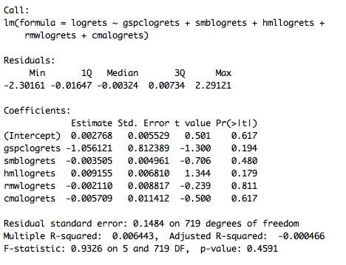
PKTEF

Slide 12
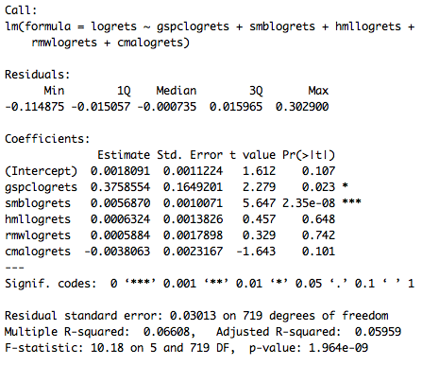
USAK

Slide 13
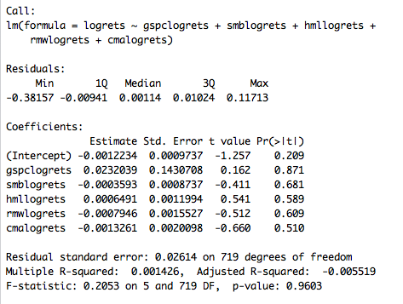
PW

Slide 14
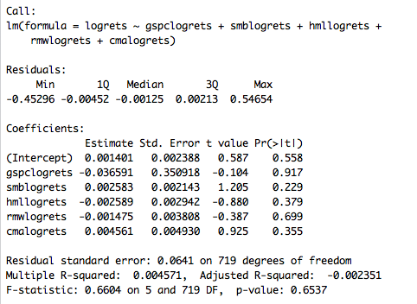
AXLE

Slide 15
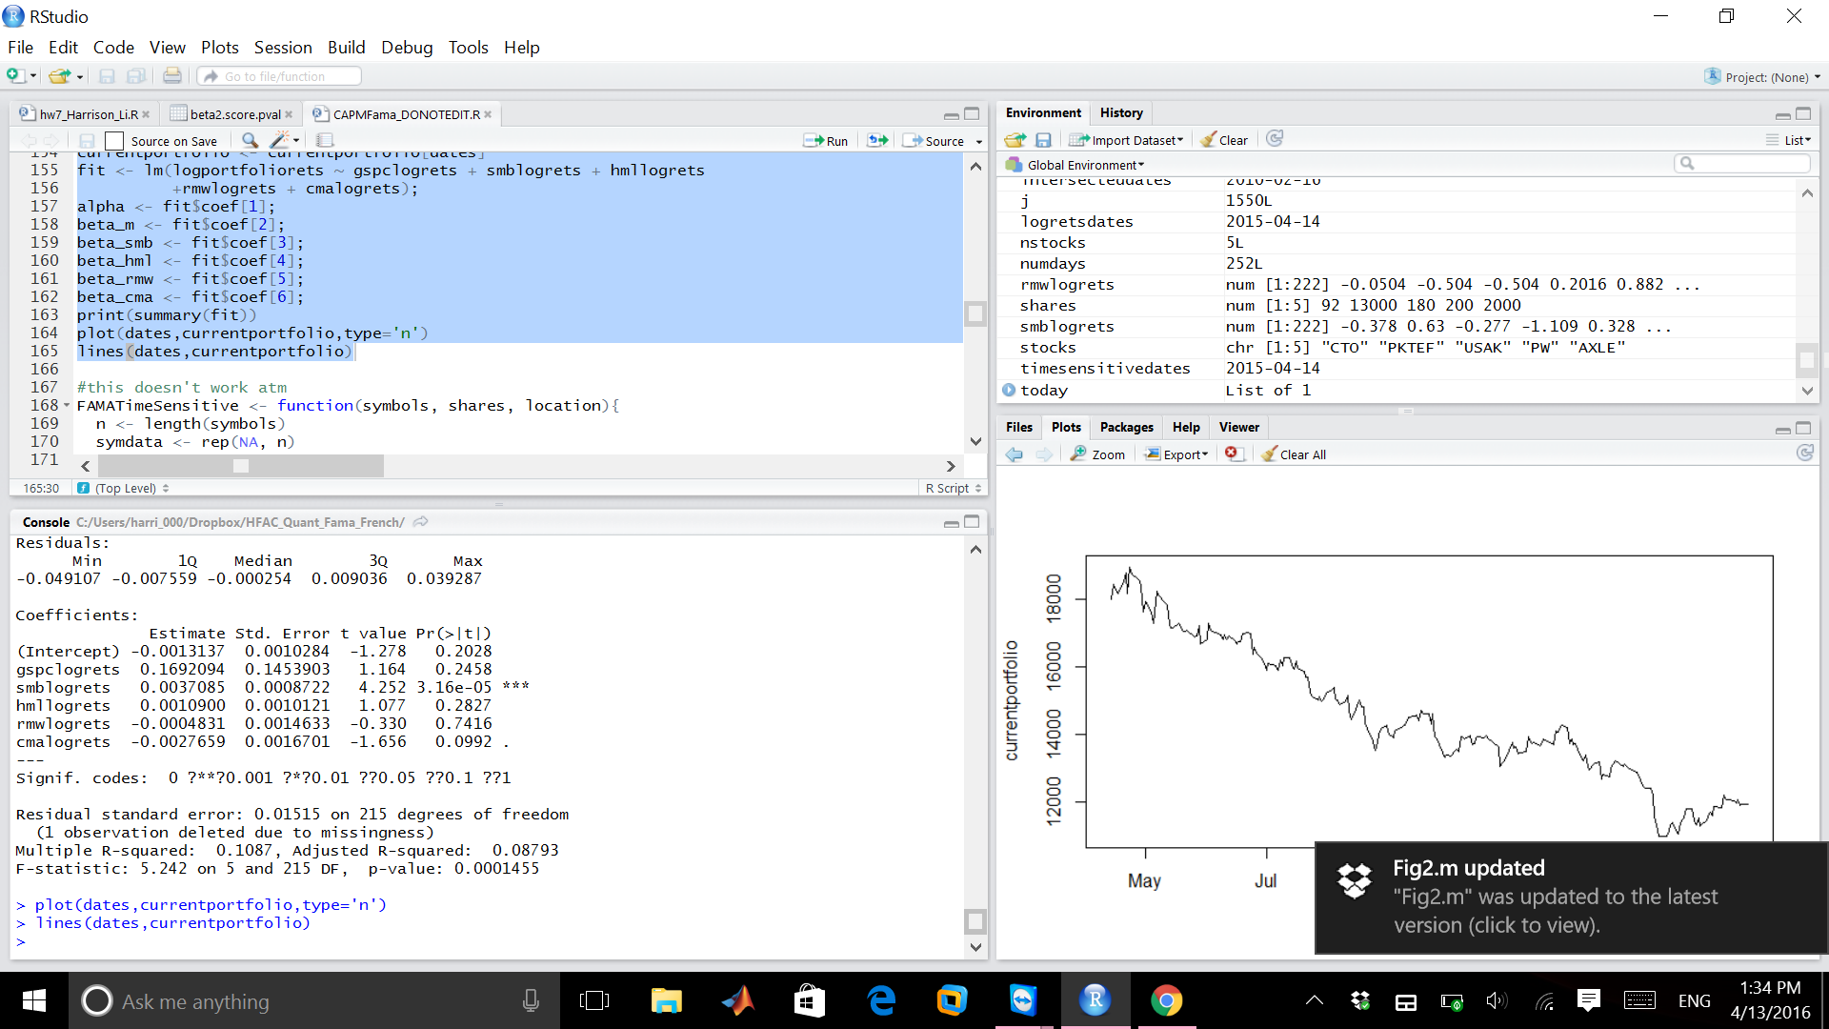
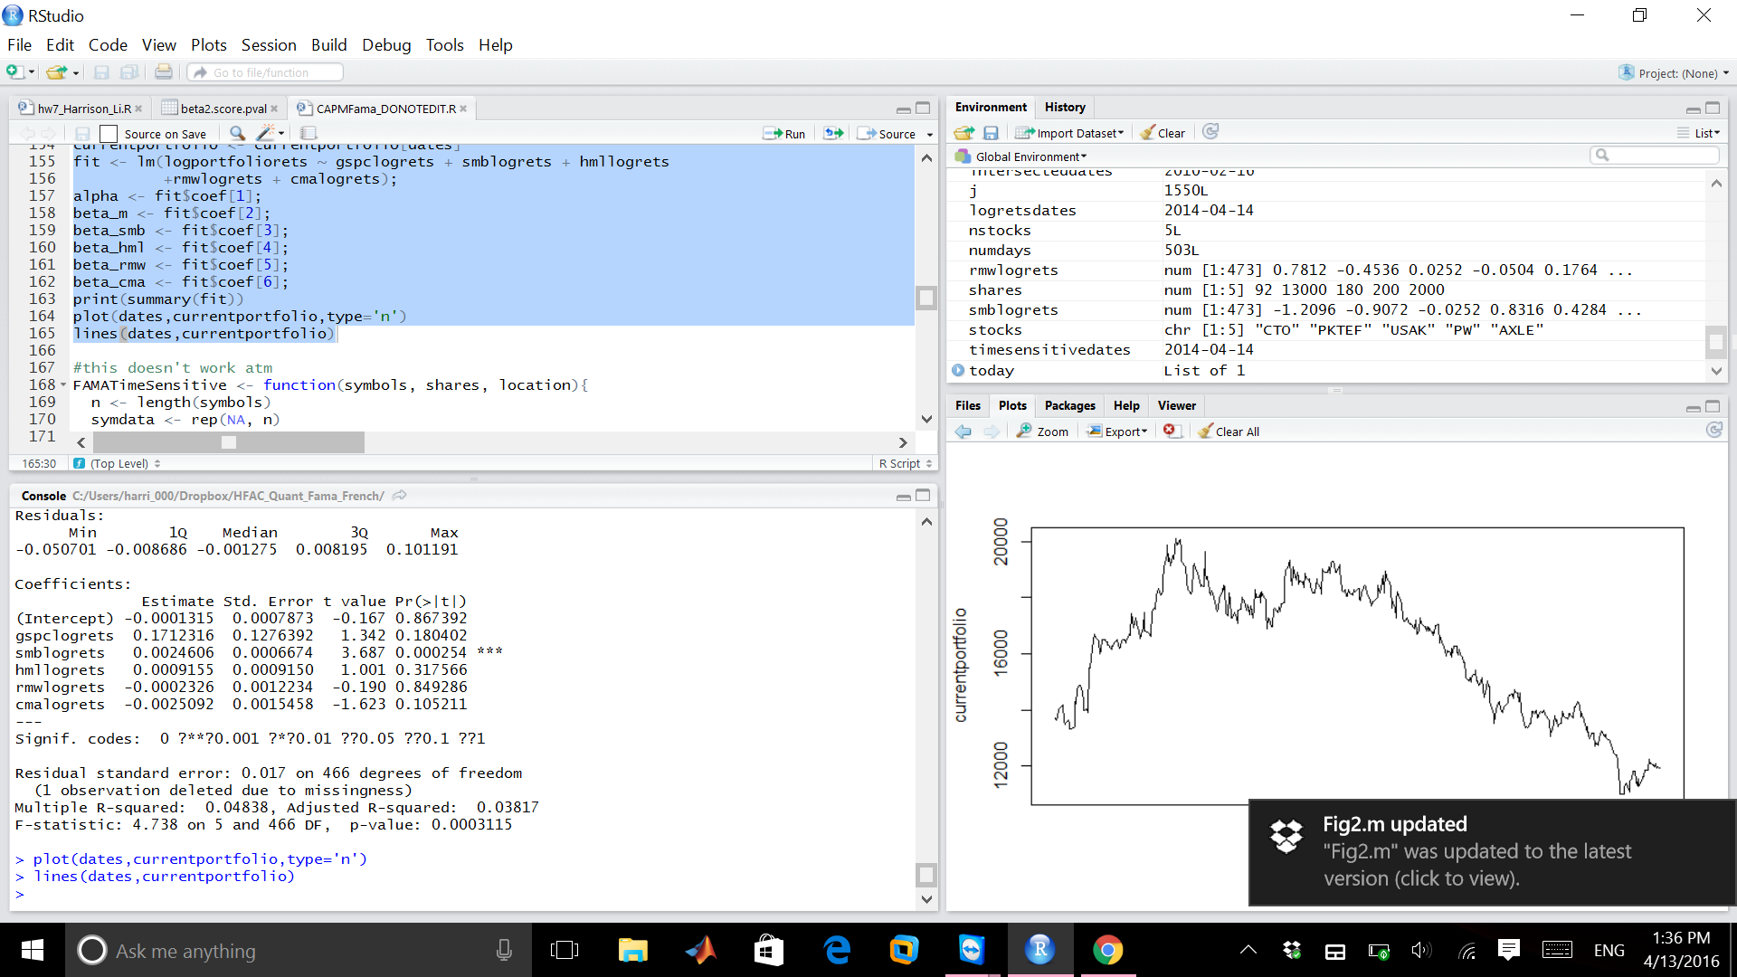
Effect of time horizon
Results on previous slide used daily returns over the last three years
Not much difference if we go to 1 or 2 years

Slide 16
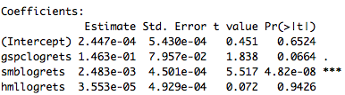
Comparison with three factor model
They look pretty similar!

Slide 17
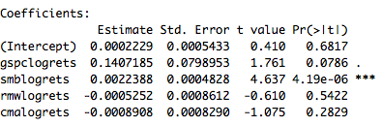
HML really does seem to be irrelevant

Slide 18
But what about the other factors? Are they needed?
AIC (Akaike Information Criterion), BIC (Bayesian Information Criterion)
Measure of relative quality of statistical models for a given set of data
AIC = 2k - 2ln(L)
L is the maximum value of the likelihood function for the model
k is the number of parameters estimated by the model
Minimizing AIC means maximizing likelihood, and minimizing # parameters
BIC = -2ln(L) + k ln(n)
BIC is very similar, but takes into account the number of data points (n)

Slide 19
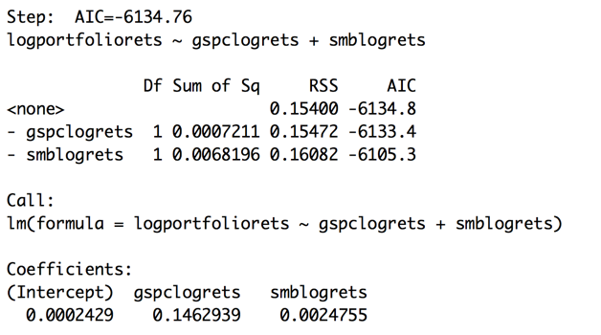
AIC Results

Slide 20
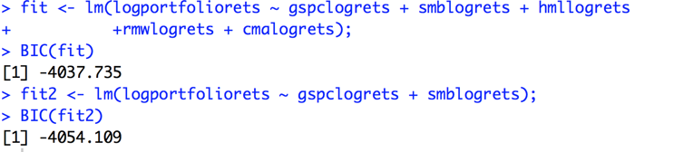
BIC Results
Using the BIC, we get the same results.

Slide 21
Conclusions
Five factor model does not show significantly different results from three factor model- additional factors are essentially zero for HFAC’s portfolio
Still no alpha (as expected)
Results surprisingly not sensitive to time period
According to information criteria, for HFAC’s portfolio only the CAPM beta and the SMB factor are not redundant

Slide 22
QUESTIONS?????

